Slide 1

NEXT WORD PREDICTION USING PRETRAINED LLMs
By
Sathish Gandhi p r
Ramya b r

Slide 2
Introduction & Problem Statement
Objective: Predict the next word in a given text using two pretrained LLMs, GPT-2 and GPT-Neo.
Tools Used: Python, PyTorch, Transformers library.
Problem: Predicting the next word in a given sentence is crucial for NLP tasks like content generation and real-time chatbots. The challenge lies in:
Handling variable-length input text.
Ensuring accurate and contextually relevant predictions.
Optimizing performance for real-time applications.
Challenges: Handling varying input lengths, ensuring high prediction accuracy, and filtering out unwanted tokens.

Slide 3
Pretrained Models
GPT-2: Transformer-based model by OpenAI for generating coherent and contextually relevant text.
GPT-Neo: Open-source alternative to GPT-3 by EleutherAI, trained on larger datasets for better generalization.
Function: Both models predict the next word based on prior context in the input text.
Datasets Used:
pizza.txt: Dataset with pizza-related text for evaluating model predictions.
NLP.txt: General NLP-related text dataset for testing the models' versatility.
Purpose: Test the models' ability to predict the next word in specific contexts (e.g., food-related and general NLP).

Slide 4
Method
Model Architecture: Both GPT-2 and GPT-Neo are Transformer-based architectures using self-attention mechanisms to predict the next word in a sequence.
Self-Attention: Allows the model to weigh the relevance of different words in a sequence when predicting the next word.
Decoder-Only Structure: The models use a decoder-only architecture for causal language modeling (autoregressive generation).
Training: Both models were pretrained on vast text datasets and fine-tuned for specific tasks.
Prediction Flow:
Tokenize input text.
Use the pretrained LLM to generate predictions for the next word.
Calculate loss and perplexity to evaluate model performance.

Slide 5
Data Preprocessing & Prediction Function
Data Preprocessing:
Input text is truncated if it exceeds 500 characters.
Tokenized using AutoTokenizer with a maximum token length of 512.
Unwanted tokens like \n and <|endoftext|> are filtered.
Prediction Function (predict_next_word):
Truncates and tokenizes input.
Uses logits to predict the next word.
Adjusts predictions using a temperature parameter to control randomness.
Returns top-k predictions and calculates loss.

Slide 6
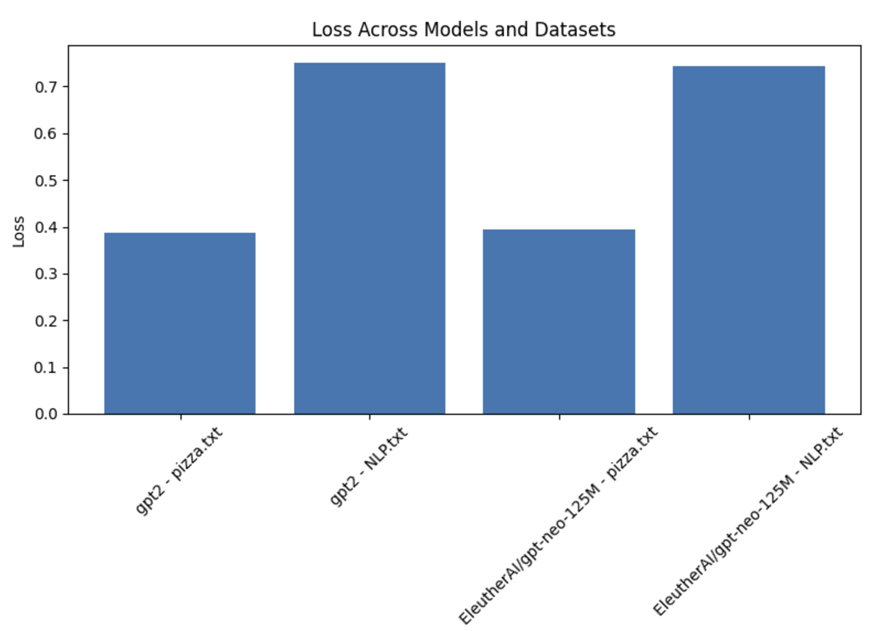
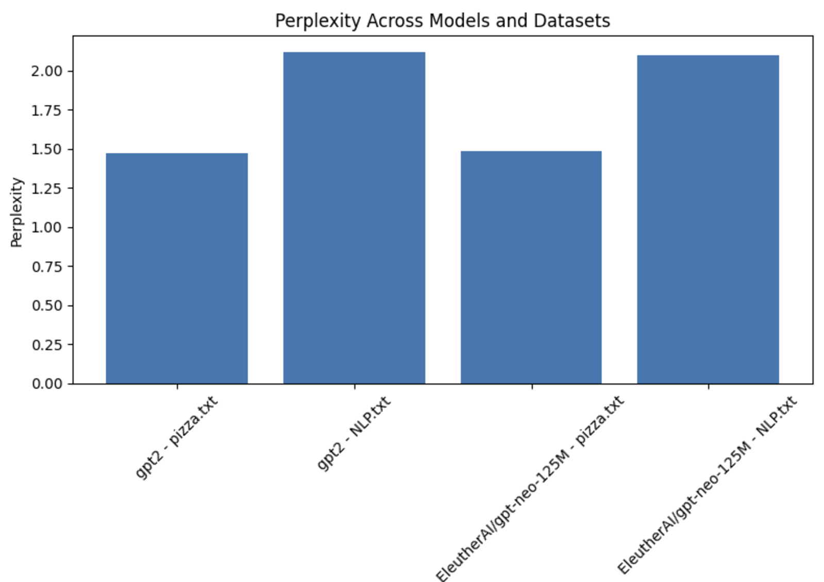
Evaluation
Loss:
Measures how well the model predicts the next word, used for evaluating performance.
Perplexity:
Exponentiation of the average loss across predictions. Lower perplexity indicates better performance.
Results:

Slide 7
Interactive Prediction Mode
Function:
interactive_prediction() allows users to input text and receive predictions for the next word.
Process:
User enters text.
Model predicts the next word and provides loss, perplexity, and top-k predictions.
Visualizes predictions using bar charts for better understanding.

Slide 8
CODE DEMO

Slide 9
Conclusion:
Summary:
GPT-2 and GPT-Neo perform well at next-word prediction, with low loss and perplexity across datasets (pizza.txt and NLP.txt).
Future Work:
Experiment with more datasets or fine-tune models for domain-specific tasks (e.g., healthcare).
Explore larger models like GPT-3 for improved predictions.

